Slide 1
Accessible Navigation

Slide 2
Navigation
Navigation is a critical aspect of accessibility
Sighted users have tried and true visual cues to orient them on a page
Banner
Search box
Main navigation box
Content well
Blind and low-vision users rely on proper coding of page for orientation
Notes:
Why can’t I animate the last bullet correctly?!?!?

Slide 3
What if you can’t see?
Title of page lets you know what page you’re on when page loads
Proper heading placement and hierarchy conveys organization of page and allows SR users to skip navigation
Link descriptions convey content of page and organization of site
Notes:
What are those holds?

Slide 4
Proper <h1> heading
Screen readers can find and list headings
<h1> heading uniquely identifies the page in the website
Should be placed directly in front of the main content of the page
The <h1> header should also match at least a subset of the the page <title>

Slide 5
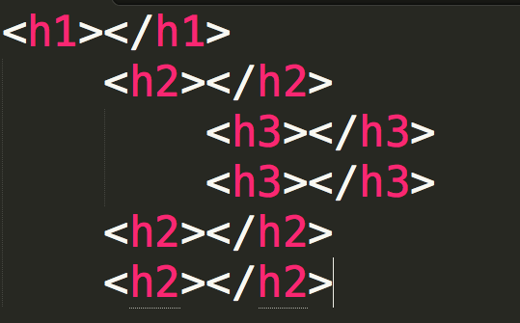
Proper heading hierarchy
Headings need to be properly nested to convey organization of the page
<h2> tags follow the <h1> tag, the <h3> tags follow the <h2> tags, etc.
Notes:
Don’t select heading levels for their default size—use CSS to style your headings.

Slide 6
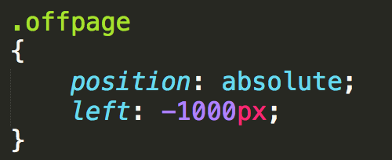
Off-page headings
Useful when you want to give SR users a navigational aid without cluttering presentation
Use CSS to position headings off-page
Don’t use {display: none} or {visibility: hidden}

Slide 7
Meaningful link text
Screen readers can find and list links
Descriptions for the links must be meaningful out of context, via tabbing or presented in a list
Don’t use “here”, “click here”, “read this”, and “more”
Don’t use URL as a link description—will sound like gibberish, unless very short and intuitive

Slide 8
Review
How easy is it to navigate your page?
What would happen if the colors weren’t there?
What would happen if you couldn’t use a mouse?
Plan for everyone

Slide 9

Acknowledgements/Contributions
These slides are Copyright 2015- Colleen van Lent as part of http://www.intro-webdesign.com/ and made available under a Creative Commons Attribution Non-Commercial 4.0 License. Please maintain this last slide in all copies of the document to comply with the attribution requirements of the license. If you make a change, feel free to add your name and organization to the list of contributors on this page as you republish the materials.
Initial Development: Colleen van Lent , University of Michigan School of Information

